Slide 1


Fundamentals of Web Development
Third Edition by Randy Connolly and Ricardo Hoar
Chapter 4b
JavaScript 2:
Using JavaScript
Copyright © 2021, 2018, 2015 Pearson Education, Inc. All Rights Reserved

Slide 2
In this chapter you will learn . . .
What is Document Object Model (DOM)
How to use the DOM to dynamically manipulate the contents of a web page
How to use the DOM and event handling to validate user input in a form
What are regular expressions and how to use them in JavaScript.

Slide 3
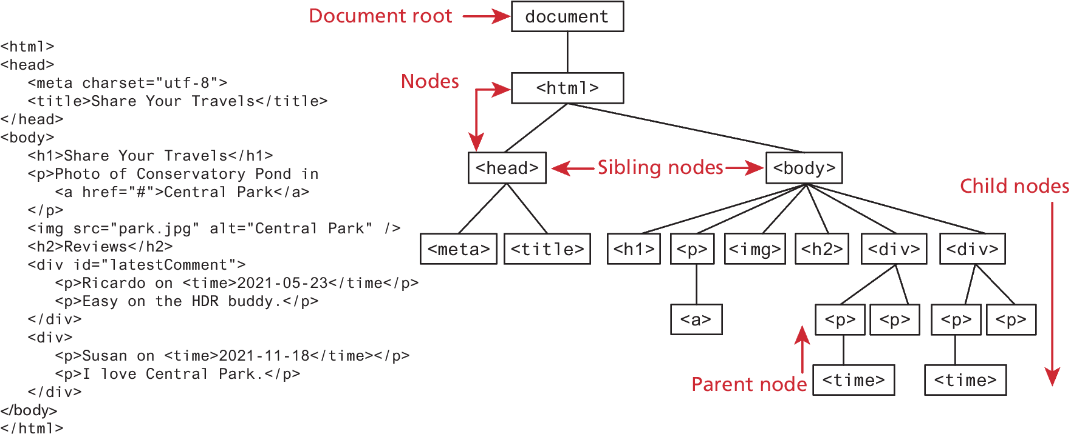
The Document Object Model (DOM)

Slide 4
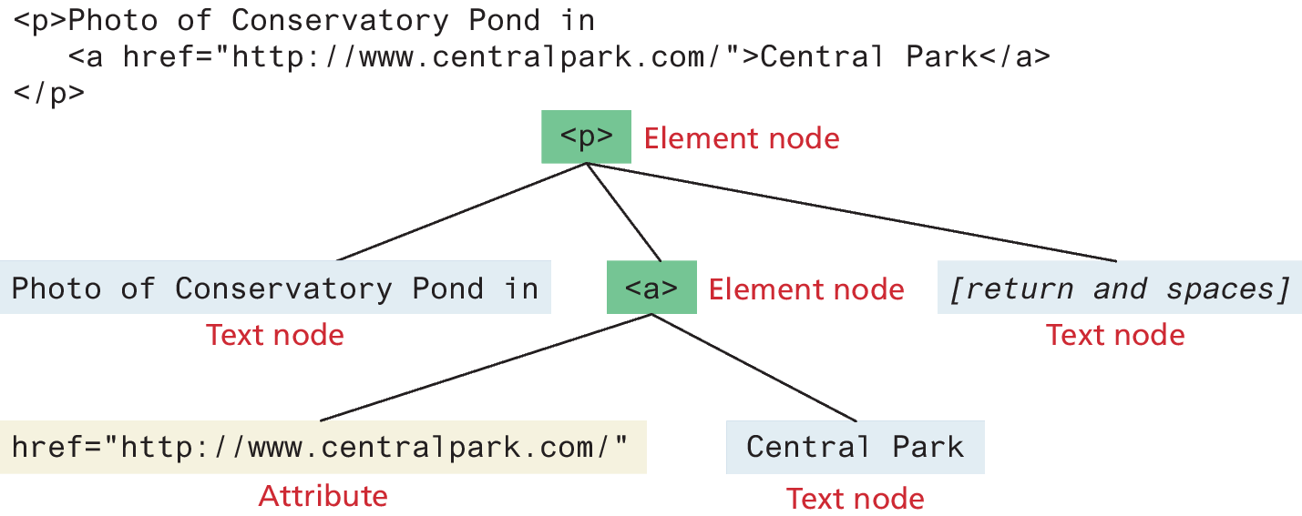
DOM Nodes and NodeLists
In the DOM, each element within the HTML document is called a node.
The DOM also defines a specialized object called a NodeList that represents a collection of nodes. It operates very similarly to an array.
Many programming tasks that we typically perform in JavaScript involve finding one or more nodes and then modifying them.

Slide 5
Some Essential Node Object Properties
childNodes A NodeList of child nodes for this node
firstChild First child node of this node
lastChild Last child of this node
nextSibling Next sibling node for this node
nodeName Name of the node
nodeType Type of the node
nodeValue Value of the node
parentNode Parent node for this node
previousSibling Previous sibling node for this node
textContent Represents the text content (stripped of any tags) of the node

Slide 6
Document Object
The DOM document object is the root JavaScript object representing the entire HTML document. It is globally accessible via the document object reference.
The properties of a document cover information about the page. Some are read-only, but others are modifiable. Like any JavaScript object, you can access its properties using either dot notation or square bracket notation
// retrieve the URL of the current page let a = document.URL; // retrieve the page encoding, for example ISO-8859-1 let b = document["inputEncoding"];

Slide 7
Document Methods
In addition to these properties, there are several essential methods you will use all the time (We used document.write() last chapter). These methods fall into three categories
Selection methods
Family manipulation methods
Event methods

Slide 8
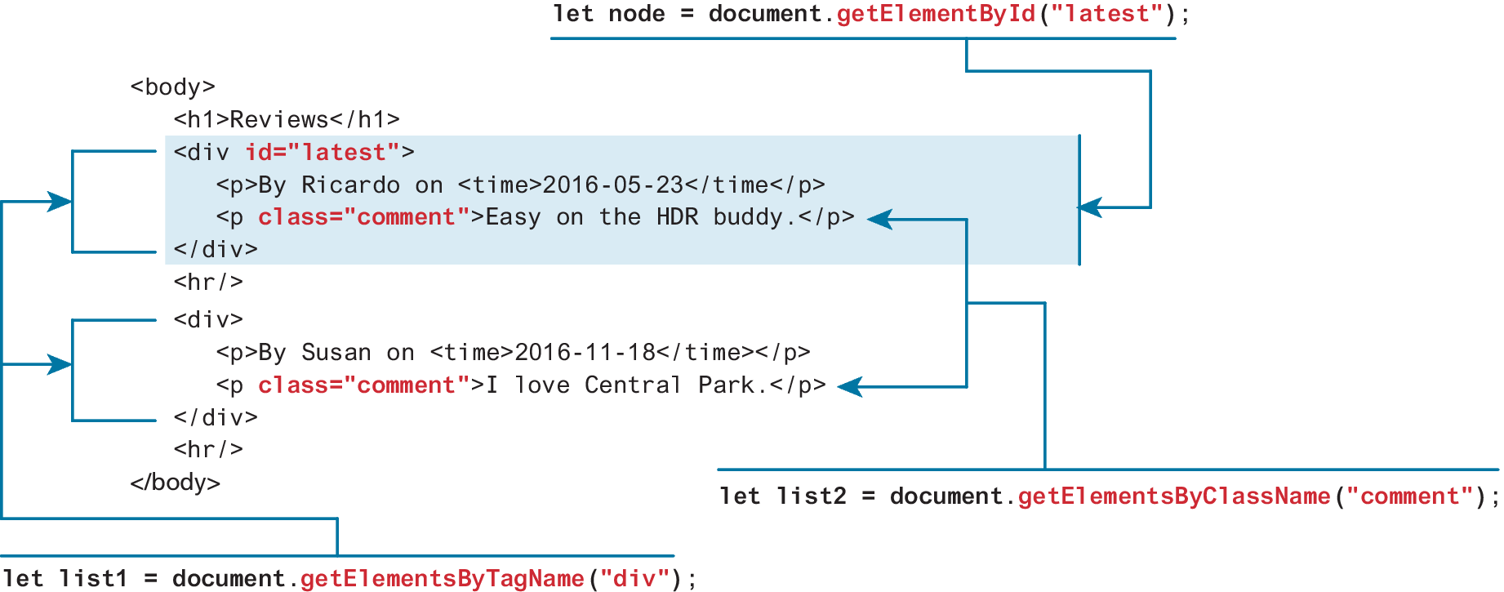
Selection Methods
The most important DOM methods
They allow you to select one or more document elements. The oldest 3 are: getElementById("id"), getElementsByClassName("name") and getElementsByTagName("name")

Slide 9
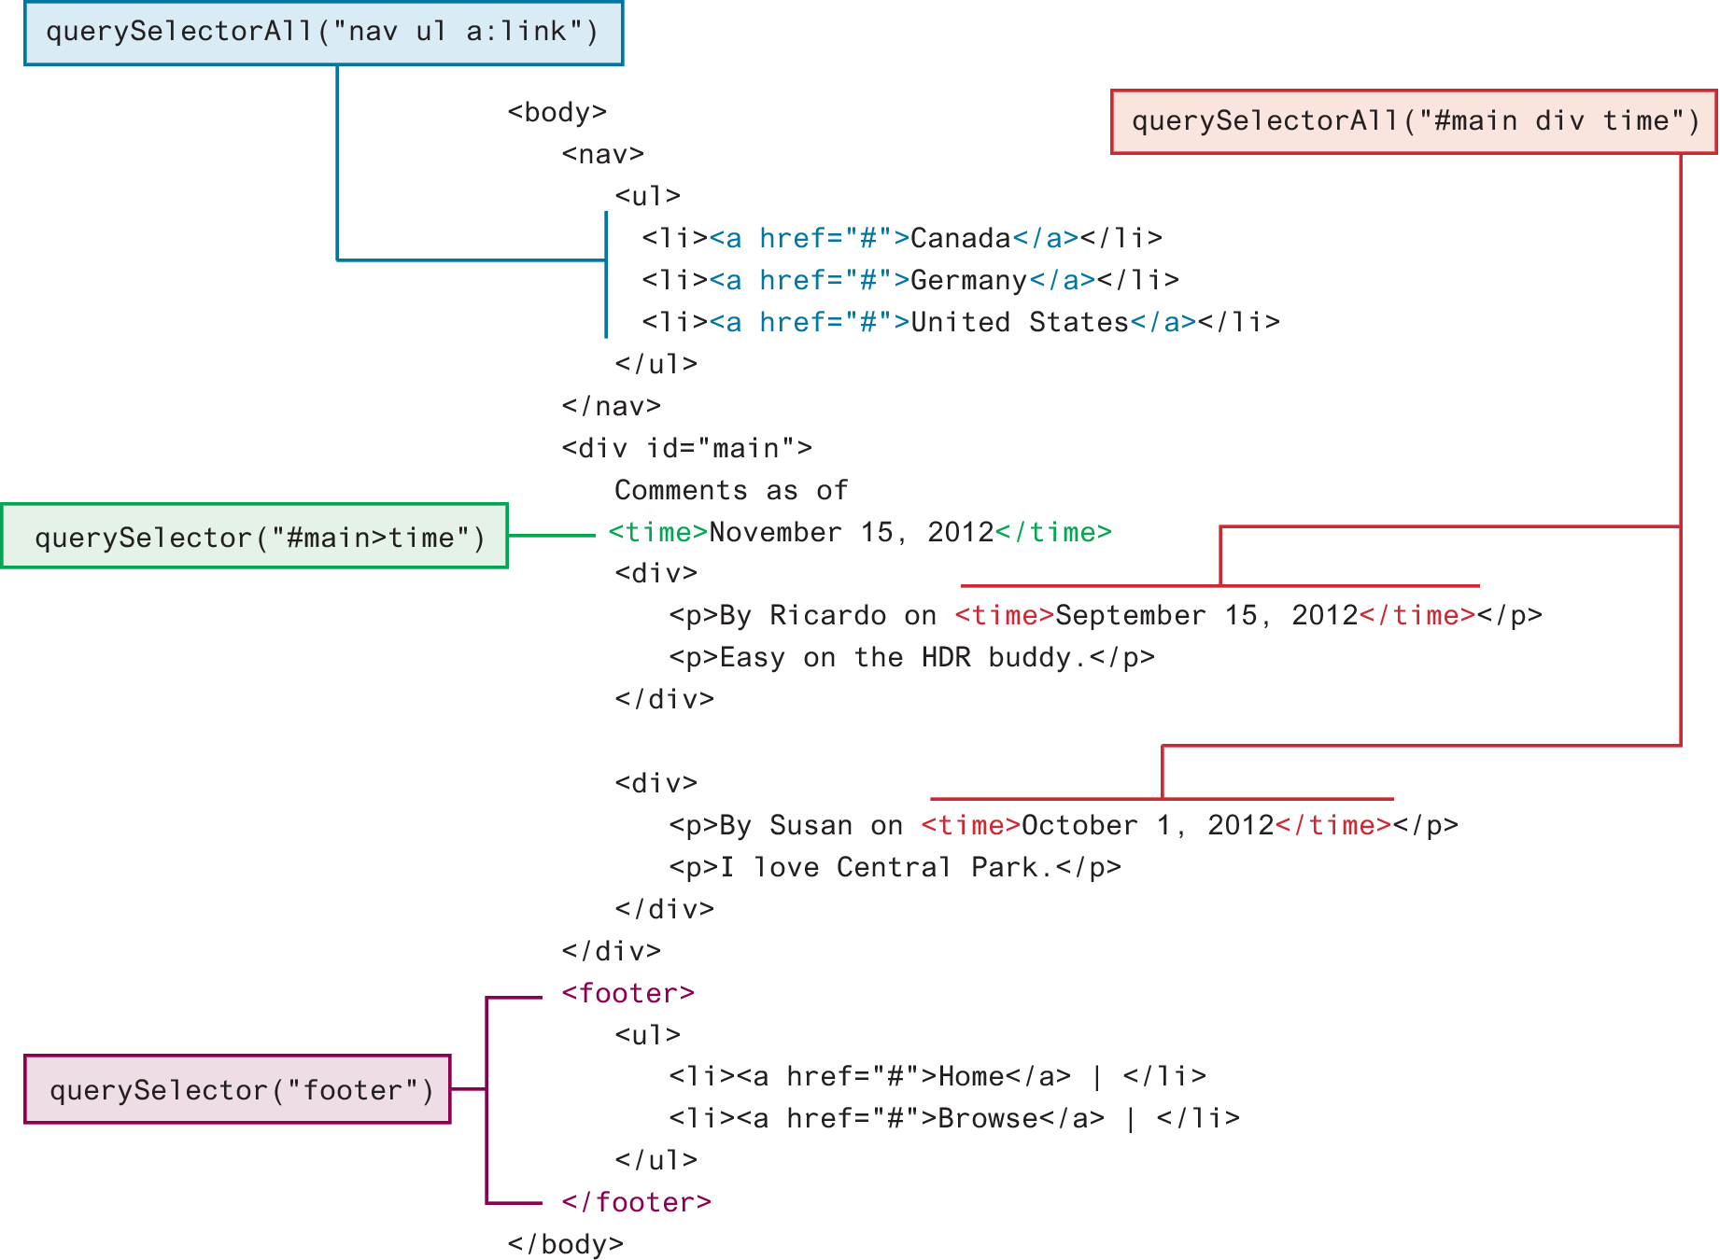
Query Selection Methods
The newer querySelector() and querySelectorAll() methods allow you to query for DOM elements much the same way you specify CSS styles

Slide 10
Element Node Object
Element Node object represents an HTML element in the hierarchy, contained between the opening <> and closing </>.
An element can itself contain more elements
Every element node has the node properties shown in Table 9.1 (slide 5)
It also has a variety of additional properties, the most important of which are shown in Table 9.3 (next slide)

Slide 11
Some Essential Element Node Properties
classList A read-only list of CSS classes assigned to this element. This list has a variety of helper methods for manipulating this list.
className The current value for the class attribute of this HTML element.
id The current value for the id of this element.
innerHTML Represents all the content (text and tags) of the element.
style The style attribute of an element. This returns a CSSStyleDeclaration object that contains sub-properties that correspond to the various CSS properties.
tagName The tag name for the element.

Slide 12
Extra Properties for Certain Tag Types
Property | Description | Tags
href | Used in <a> tags to specify the linking URL. | a
name | Used to identify a tag. Unlike id which is available to all tags, name is limited to certain form-related tags. | a, input, textarea, form
src | Links to an external URL that should be loaded into the page (as opposed to href which is a link to follow when clicked). | img, input, iframe, script
value | Provides access to the value attribute of input tags. Typically used to access the user’s input into a form field. | input, textarea, submit
TABLE 9.4 Some Specific HTML DOM Element Properties for Certain Tag Types

Slide 13
Accessing elements and their properties
<p id="here">hello <span>there</span></p>
<ul>
<li>France</li>
<li>Spain</li>
<li>Thailand</li>
</ul>
<div id="main">
<a href="somewhere.html">
<img src="whatever.gif" class="thumb">
</a>
</div>
<script>
const node = document.getElementById("here");
console.log(node.innerHTML); // hello <span>there</span>
console.log(node.textContent); //“hello there”
const items = document.getElementsByTagName("li");
for (let i=0; i<items.length; i++) {
// outputs: France, then Spain, then Thailand
console.log(items[i].textContent);
}
const link = document.querySelector("#main a");
console.log(link.href); // outputs: somewhere.html
const img = document.querySelector("#main img");
console.log(img.src); // outputs: whatever.gif
console.log(img.className); // outputs: thumb
</script>
LISTING 9.1 Accessing elements and their properties

Slide 14
Modifying the DOM
Now that you can access some of the node and element properties you might be wondering how one can make use of some of these properties. Since most of the properties listed in the previous tables are all read and write, this means that they can be programmatically changed.
Changing an Element’s Style
Changing the content of any given element
DOM Manipulation Methods

Slide 15
Changing an Element’s Style
To programmatically modify the styles associated with a particular element one must change the properties of the style property for that element
For instance, to change an element’s background color and add a three pixel border, we could use the following code:
const node = document.getElementById("someId");
node.style.backgroundColor = "#FFFF00";
node.style.borderWidth = "3px";

Slide 16
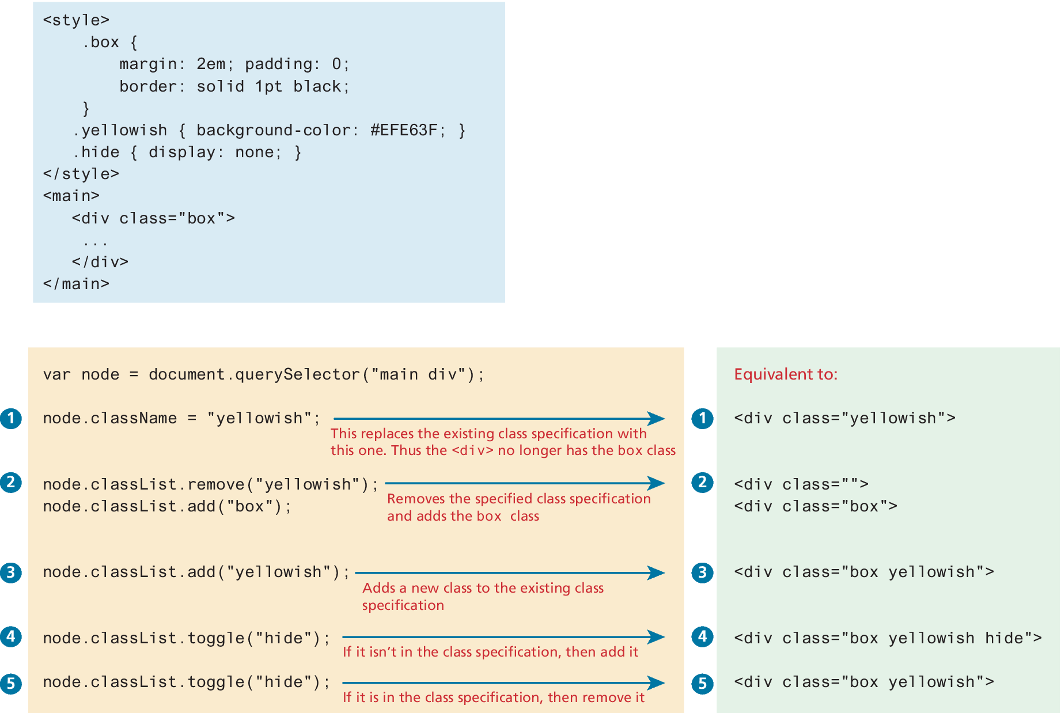
How CSS styles can be programmatically manipulated in JavaScript
While you can directly change CSS style elements via this style property, it is generally preferable to change the appearance of an element instead using the className or classList properties

Slide 17
InnerHTML vs textContent vs DOM Manipulation
Listing 9.1 (slide 13) illustrated how you can programmatically access the content of an element node through its innerHTML or textContent property. These properties can also be used to modify the content of any given element.
For instance, you could change the content of the <div> in Listing 9.1 using the following:
const div = document.querySelector("#main");
div.innerHTML = '<a href="#"><img src="ab.gif"></a>’;
This replaces the existing content with the new content.

Slide 18
InnerHTML vs textContent vs DOM Manipulation (ii)
Using innerHTML is generally discouraged (even though you will likely see many examples online that use these approaches) because they are potentially vulnerable to Cross-Site Scripting (XSS) attacks
In practice, when you need to change the inner text of an element, it is preferable to use the textContent property instead of innerHTML since any markup is stripped from it.
In addition, when you need to generate HTML elements, it is better to use the appropriate DOM manipulation methods covered in the next section

Slide 19
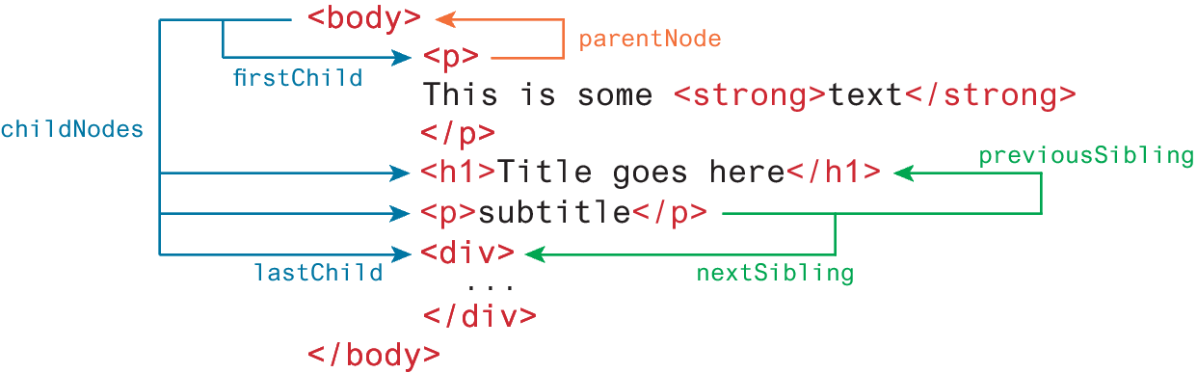
DOM family relations
Each node in the DOM has a variety of “family relations” properties and methods for navigating between elements and for adding or removing elements from the document hierarchy.
Child and sibling properties can be an unreliable mechanism for selecting nodes and thus, in general, you will instead use selector methods

Slide 20
DOM Manipulation Methods
appendChild Adds a new child node to the end of the current node.
createAttribute Creates a new attribute node.
createElement Creates an HTML element node.
createTextNode Creates a text node.
insertAdjacentElement Inserts a new child node at one of four positions relative to the current node.
insertAdjacentText Inserts a new text node at one of four positions relative to the current node.
insertBefore Inserts a new child node before a reference node in the current node.
removeChild Removes a child from the current node.
replaceChild Replaces a child node with a different child.

Slide 21
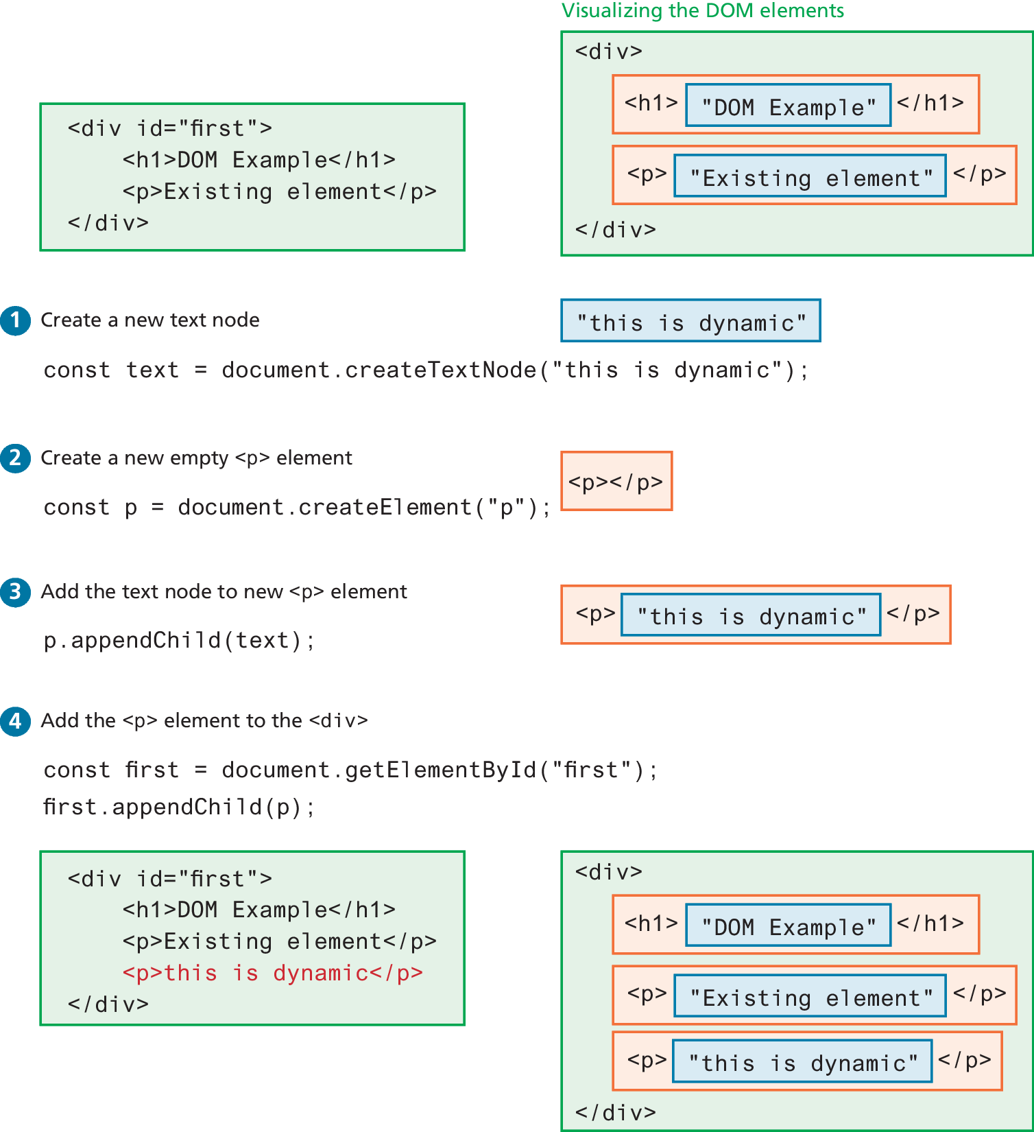
Visualizing the DOM modification

Slide 22
Visualizing the DOM modification (ii)

Slide 23
DOM Timing
Before finishing this section on using the DOM, it should be emphasized that the timing of any DOM code is very important.
You cannot access or modify the DOM until it has been loaded.
If the DOM programming is written after the markup as in Listing 9.2 that should ensure that the elements exist in the DOM before the code executes.
To wait until we know for sure that the DOM has been loaded requires knowledge from our next section on event handling.

Slide 24
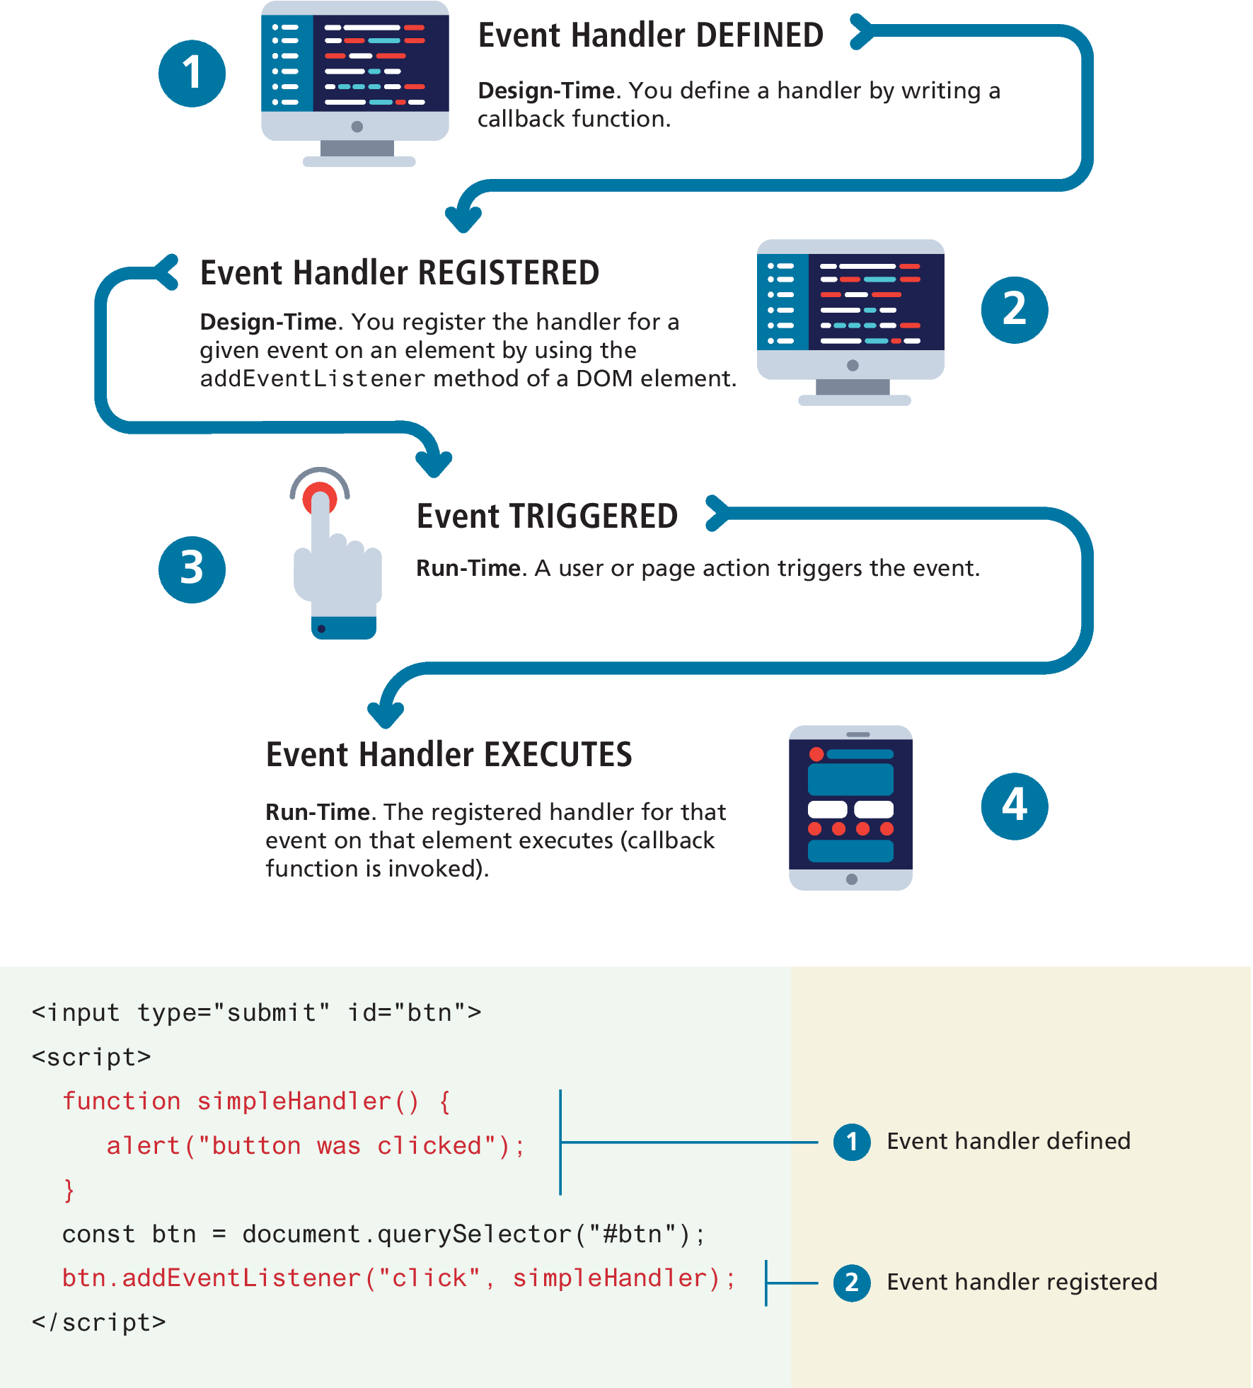
JavaScript Event Handling

Slide 25
Implementing an Event Handler
An event handler is first defined, then registered to an element node object.
Registering an event handler requires passing a callback function to the addEventListener()

Slide 26
Listening with an anonymous function
It is much more common to make use of an anonymous function passed to addEventListener()
const btn = document.getElementById("btn");
btn.addEventListener("click", function () {
alert("used an anonymous function");
});
document.querySelector("#btn").addEventListener("click", function (){
alert("a different approach but same result");
});
document.querySelector("#btn").addEventListener("click", () => {
alert("arrow syntax but same result");
});
LISTING 9.3 Listening to an event with an anonymous function, three versions

Slide 27
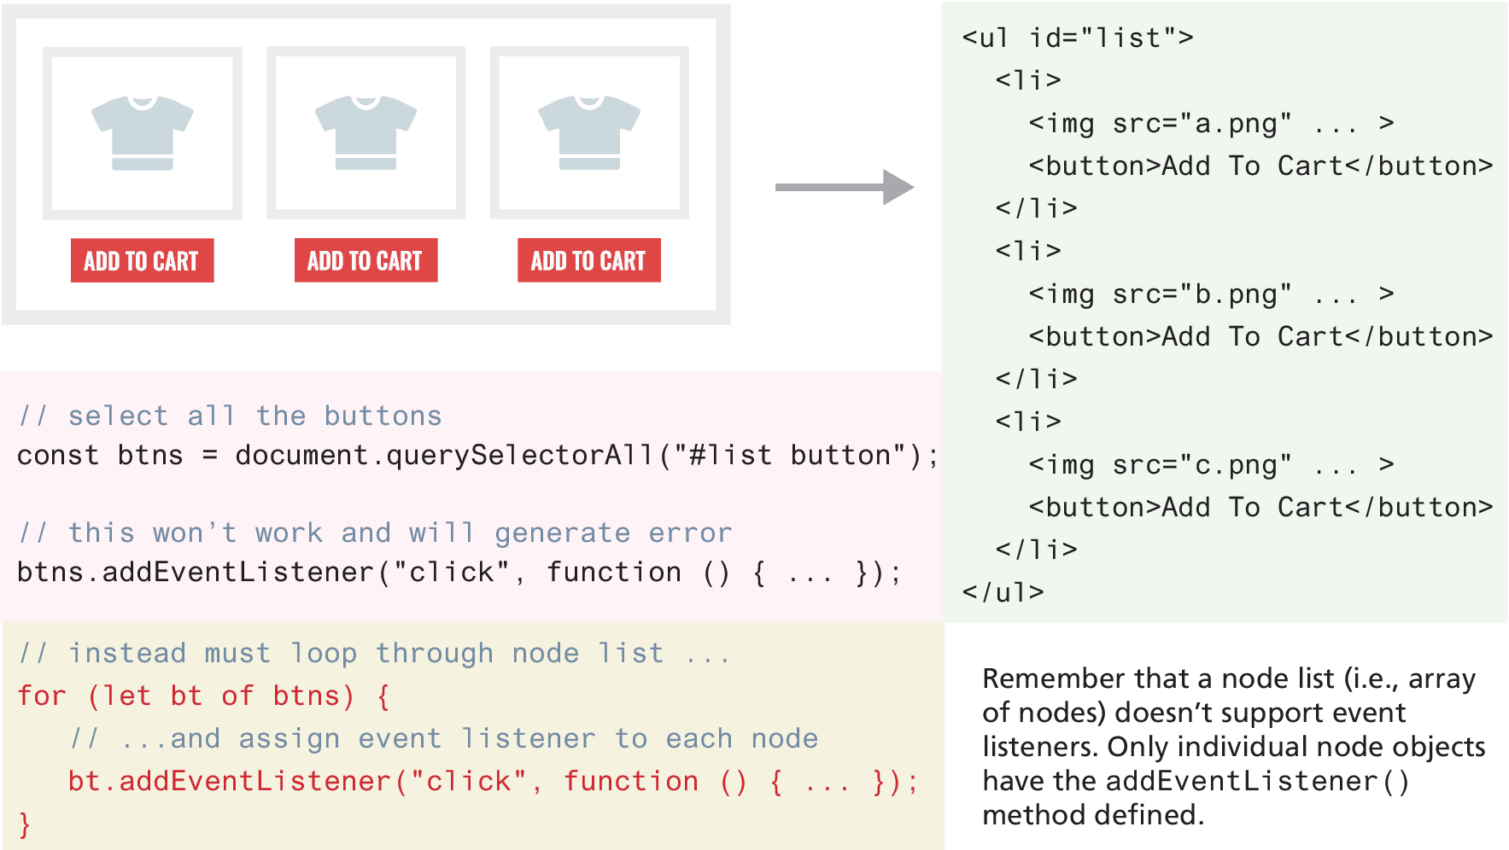
Event handling with NodeList arrays

Slide 28
Page Loading and the DOM
To ensure your DOM manipulation code after the page is loaded use one of the following two different page load events.
window.load Fires when the entire page is loaded. This includes images and stylesheets, so on a slow connection or a page with a lot of images, the load event can take a long time to fire.
document.DOMContentLoaded Fires when the HTML document has been completely downloaded and parsed. Generally, this is the event you want to use.
Using one of these, your DOM coding can now appear anywhere, including within the <head> element, which is the conventional place to add in your JavaScript code.

Slide 29
Wrapping DOM code within a DOMContentLoaded event handler
document.addEventListener('DOMContentLoaded', function() {
const menu = document.querySelectorAll("#menu li");
for (let item of menu) {
item.addEventListener("click", function () {
item.classList.toggle('shadow’);
});
}
const heading = document.querySelector("h3");
heading.addEventListener('click', function() {
heading.classList.toggle('shadow’);
});
});
LISTING 9.4 Wrapping DOM code within a DOMContentLoaded event handler

Slide 30
Event Object
When an event is triggered, the browser will construct an event object that contains information about the event.
Your event handlers can access this event object simply by including it as an argument to the callback function (by convention, this event object parameter is often named e)

Slide 31
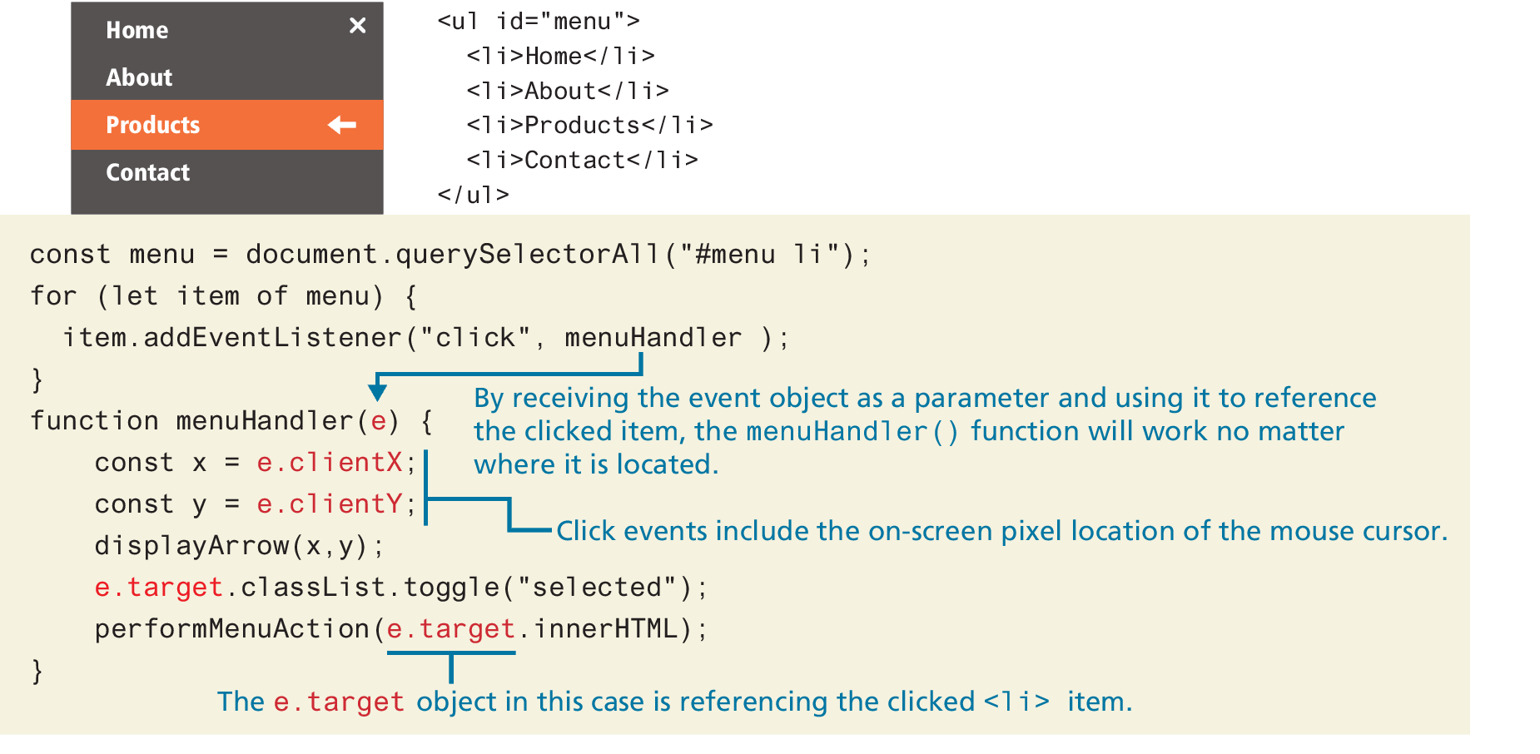
Event Object Example

Slide 32
Event Propagation
When an event fires on an element that has ancestor elements, the event propagates to those ancestors. There are two distinct phases of propagation:
In the event capturing phase, the browser checks the outermost ancestor (the <html> element) to see if that element has an event handler registered for the triggered event, and if so, it is executed. It then proceeds to the next ancestor and performs the same steps; this continues until it reaches the element that triggered the event (that is, the event target).
In the event bubbling phase, the opposite occurs. The browser checks if the element that triggered the event has an event handler registered for that event, and if so, it is executed.

Slide 33
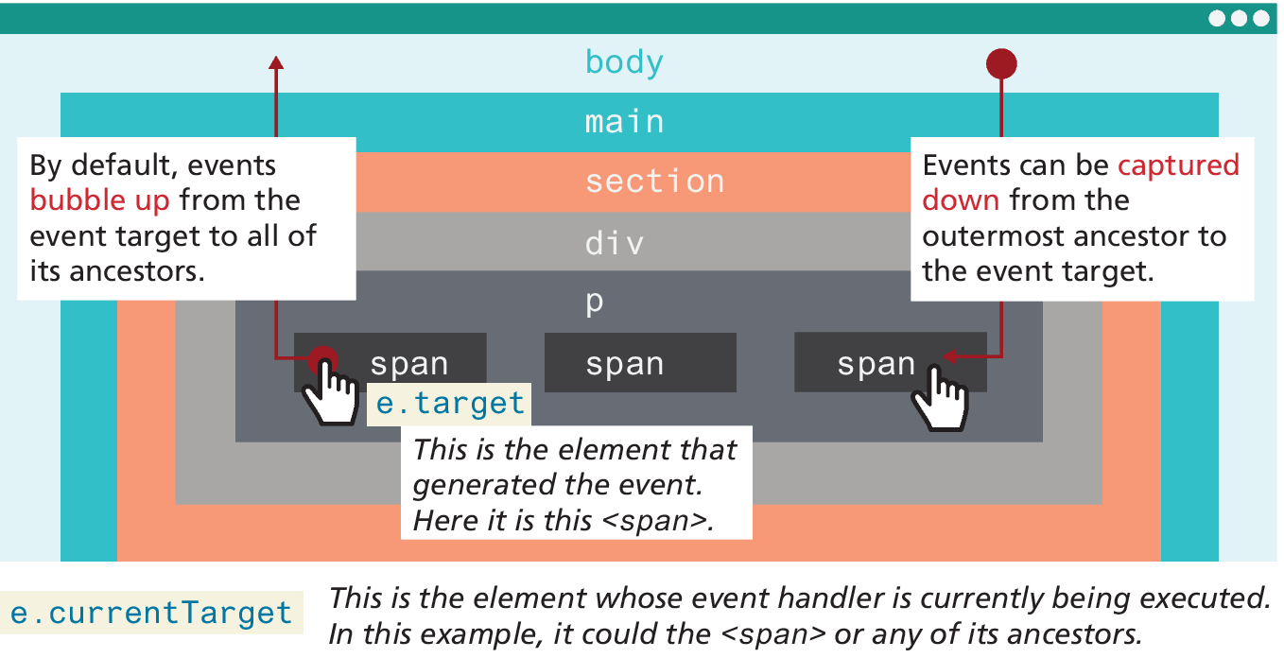
Event capture and bubbling

Slide 34
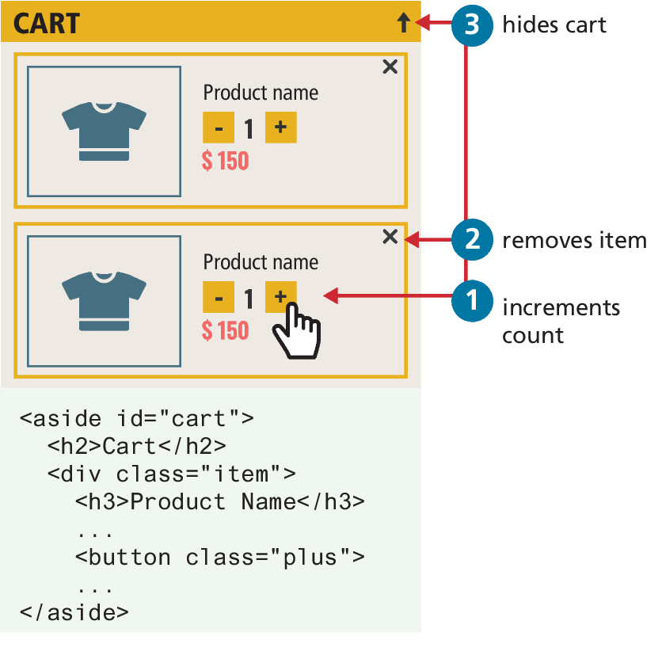
Problems with event propagation
Occasionally, the bubbling of events can cause problems. For instance consider elements nested within one another, each with its own on-click behaviors.
When the user clicks on the increment count button, the click handler for the increment <button> will trigger first. Unfortunately, it will then trigger the click event for the <div>, and the <aside> element!
Thankfully, there is a solution to such problems. The stopPropagation() method of the event argument object will stop event propagation.

Slide 35
Stopping event propagation
const btns = document.querySelectorAll(".plus");
for (let b of btns) {
b.addEventListener("click", function (e) {
e.stopPropagation();
incrementCount(e);
});
}
const items = document.querySelectorAll(".item");
for (let it of items) {
it.addEventListener("click", function (e) {
e.stopPropagation();
removeItemFromCart(e);
});
}
const aside = document.querySelector("aside#cart");
aside.addEventListener("click", function () {
minimizeCart();
});
LISTING 9.5 Stopping event propagation

Slide 36
Event Delegation
To avoid creating duplicate event handlers for each element within a NodeList, an alternative is to use event delegation where we assign a single listener to the parent and make use of event bubbling
Suppose we have numerous image thumbnails within a parent element, similar to the following:
<body>
<header>...</header>
<main>
<section id="list">
<h2>Section Title</h2>
<img ... />
<img ... />
...
</section>
</main>
</body>

Slide 37
Event Delegation (ii)
Now what if you wanted to do something special when the user clicks the mouse on an <img>
You would probably write something like the following:
Notice that this solution adds an event listener to every <img> element.
const images = document.querySelectorAll("#list img");
for (let img of images) {
img.addEventListener("click", someHandler);
}

Slide 38
Event Delegation (iii)
Instead, we can add a single listener to the parent element, as shown in the following code
Since the user can click on all elements within the <section> element (as can be seen in Figure 9.15), the click event handler needs to determine if the user has clicked on one of the <img> elements within it.
const parent = document.querySelector("#list");
parent.addEventListener("click", function (e) {
// e.target is the object that generated the event.
// to verify that e.target exists and that it is one of the
// <img> elements. Note: NodeName always returns //upper case
if (e.target && e.target.nodeName == "IMG") {
doSomething(e.target);
}
});

Slide 39
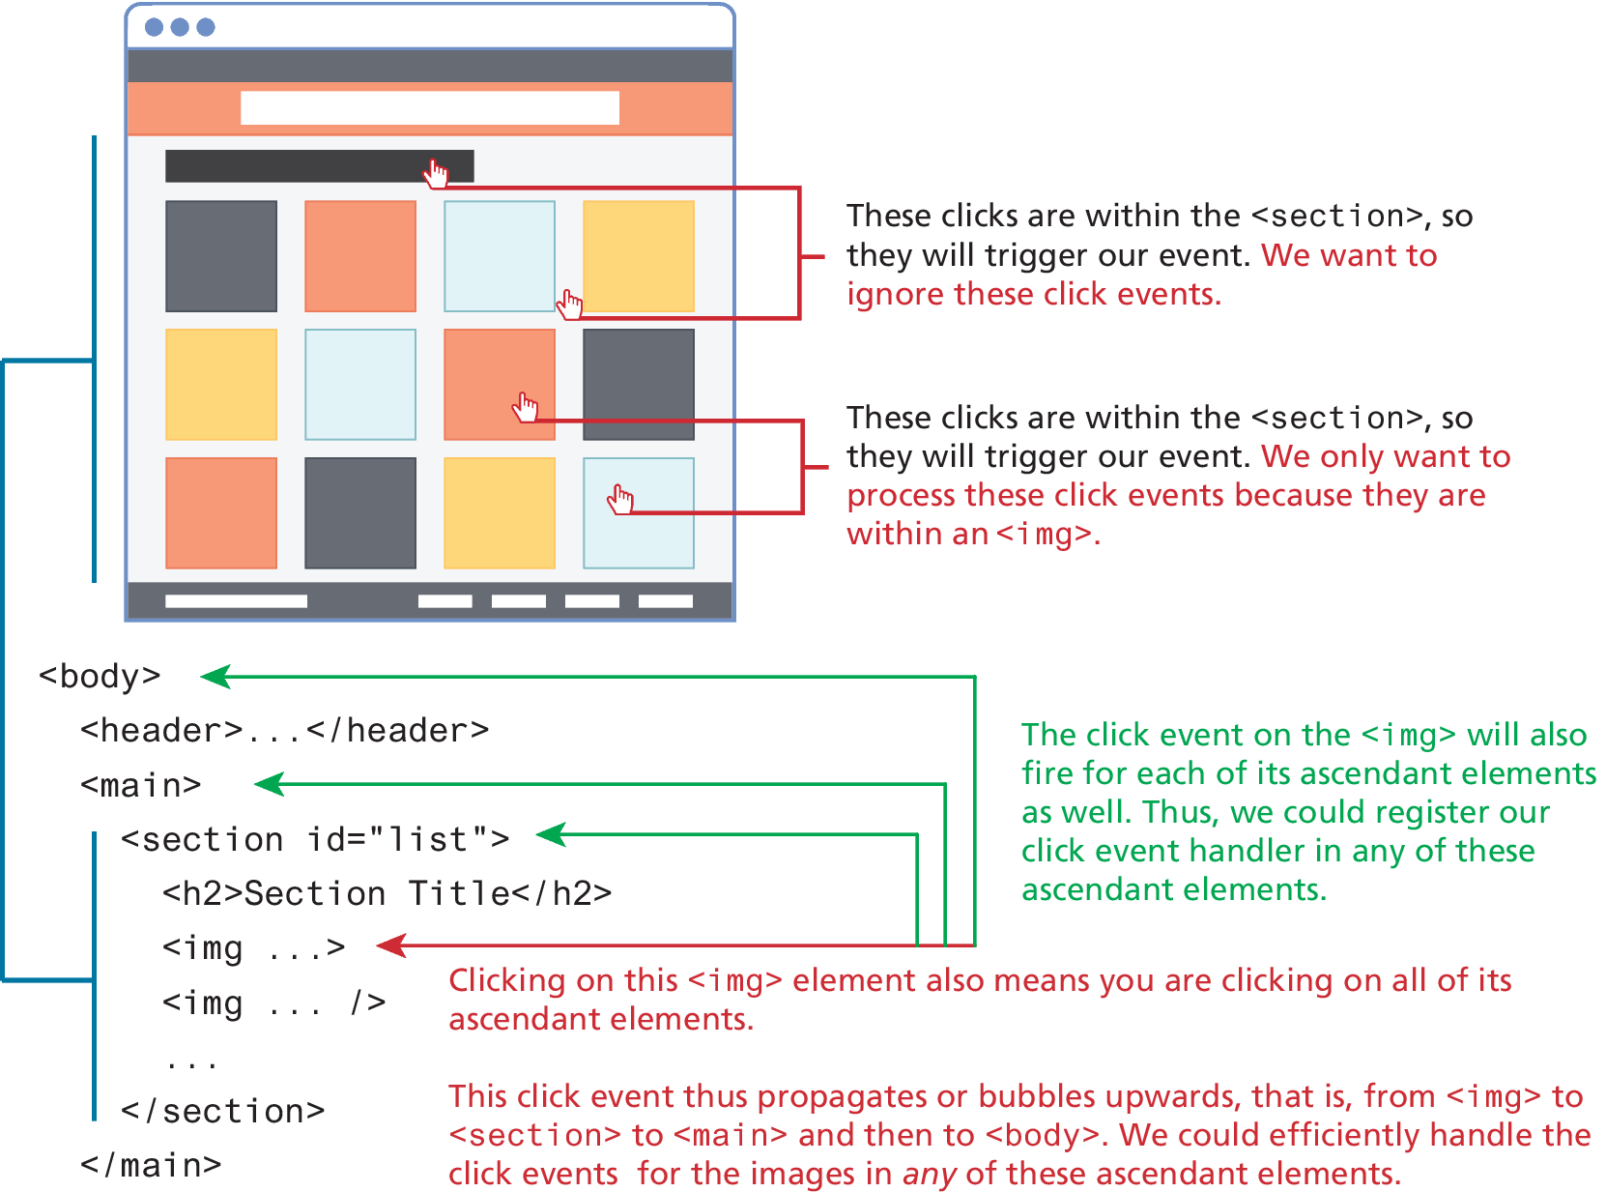
Event Delegation (iv)

Slide 40
Using the Dataset Property
One of the more challenging aspects of writing JavaScript involves differences in timing between what variables are available to a function handler when it is being defined and what variables are available to that same function when it is being executed.
The solution is to make use of the dataset property of the DOM element, which provides read/write access to custom data attributes (data-*) set on the element. For instance, you can make use of these via markup or via JavaScript. In markup, it can be added to any element as shown in the following:
<img src='file.png' id='a' data-id='5' data-country='Peru' />

Slide 41
Event Types
There are many different types of events that can be triggered in the browser. Perhaps the most obvious event is the click event, but JavaScript and the DOM support several others.
In actuality, there are several classes of event, with several types of events within each class specified by the W3C. Some of the most commonly used event types are:
mouse events,
keyboard events,
touch events,
form events, and
frame events.

Slide 42
Mouse Events
click The mouse was clicked on an element.
dblclick The mouse was double clicked on an element.
mousedown The mouse was pressed down over an element.
mouseup The mouse was released over an element.
mouseover The mouse was moved (not clicked) over an element.
mouseout The mouse was moved off of an element.
mousemove The mouse was moved while over an element.

Slide 43
Keyboard Events
Keyboard events are often overlooked by novice web developers, but are important tools for power users.
keydown The user is pressing a key (this happens first).
keyup The user releases a key that was down (this happens last).
document.getElementById("key").addEventListener("keydown", function (e) {
// get the raw key code
let keyPressed=e.key;
// convert to string
let character=String.fromCharCode(keyPressed);
alert("Key " + character + " was pressed");
});
LISTING 9.7 Listener that hears and alerts key presses

Slide 44
Form Events
blur Triggered when a form element has lost focus (i.e., control has moved to a different element), perhaps due to a click or Tab key press.
change Some <input>, <textarea>, or <select> field had their value change. This could mean the user typed something, or selected a new choice.
focus Complementing the blur event, this is triggered when an element gets focus (the user clicks in the field or tabs to it).
reset HTML forms have the ability to be reset. This event is triggered when that happens.
select When the users selects some text. This is often used to try and prevent copy/paste.
submit When the form is submitted this event is triggered. We can do some prevalidation of the form in JavaScript before sending the data on to the server.

Slide 45
Handling the submit event
document.querySelector("#loginForm").addEventListener("submit",
function(e) {
let pass = document.querySelector("#pw").value;
if (pass=="") {
alert ("enter a password");
e.preventDefault();
}
});
LISTING 9.8 Handling the submit event

Slide 46
Media Events
ended Triggered when playback of audio or video element is completed.
pause Triggered when playback is paused.
play Triggered when playback is no longer paused.
ratechange Triggered when playback speed changes.
volumechange Triggered when audio volume has changed.

Slide 47
Frame Events
abort An object was stopped from loading.
error An object or image did not properly load.
load When window content is fully loaded.
DOMContentLoaded When DOM elements in document are loaded.
orientationchange The device‘s orientation has changed from portrait to landscape, or vice-versa.
resize The document view was resized.
scroll The document view was scrolled.
unload The document has unloaded.

Slide 48
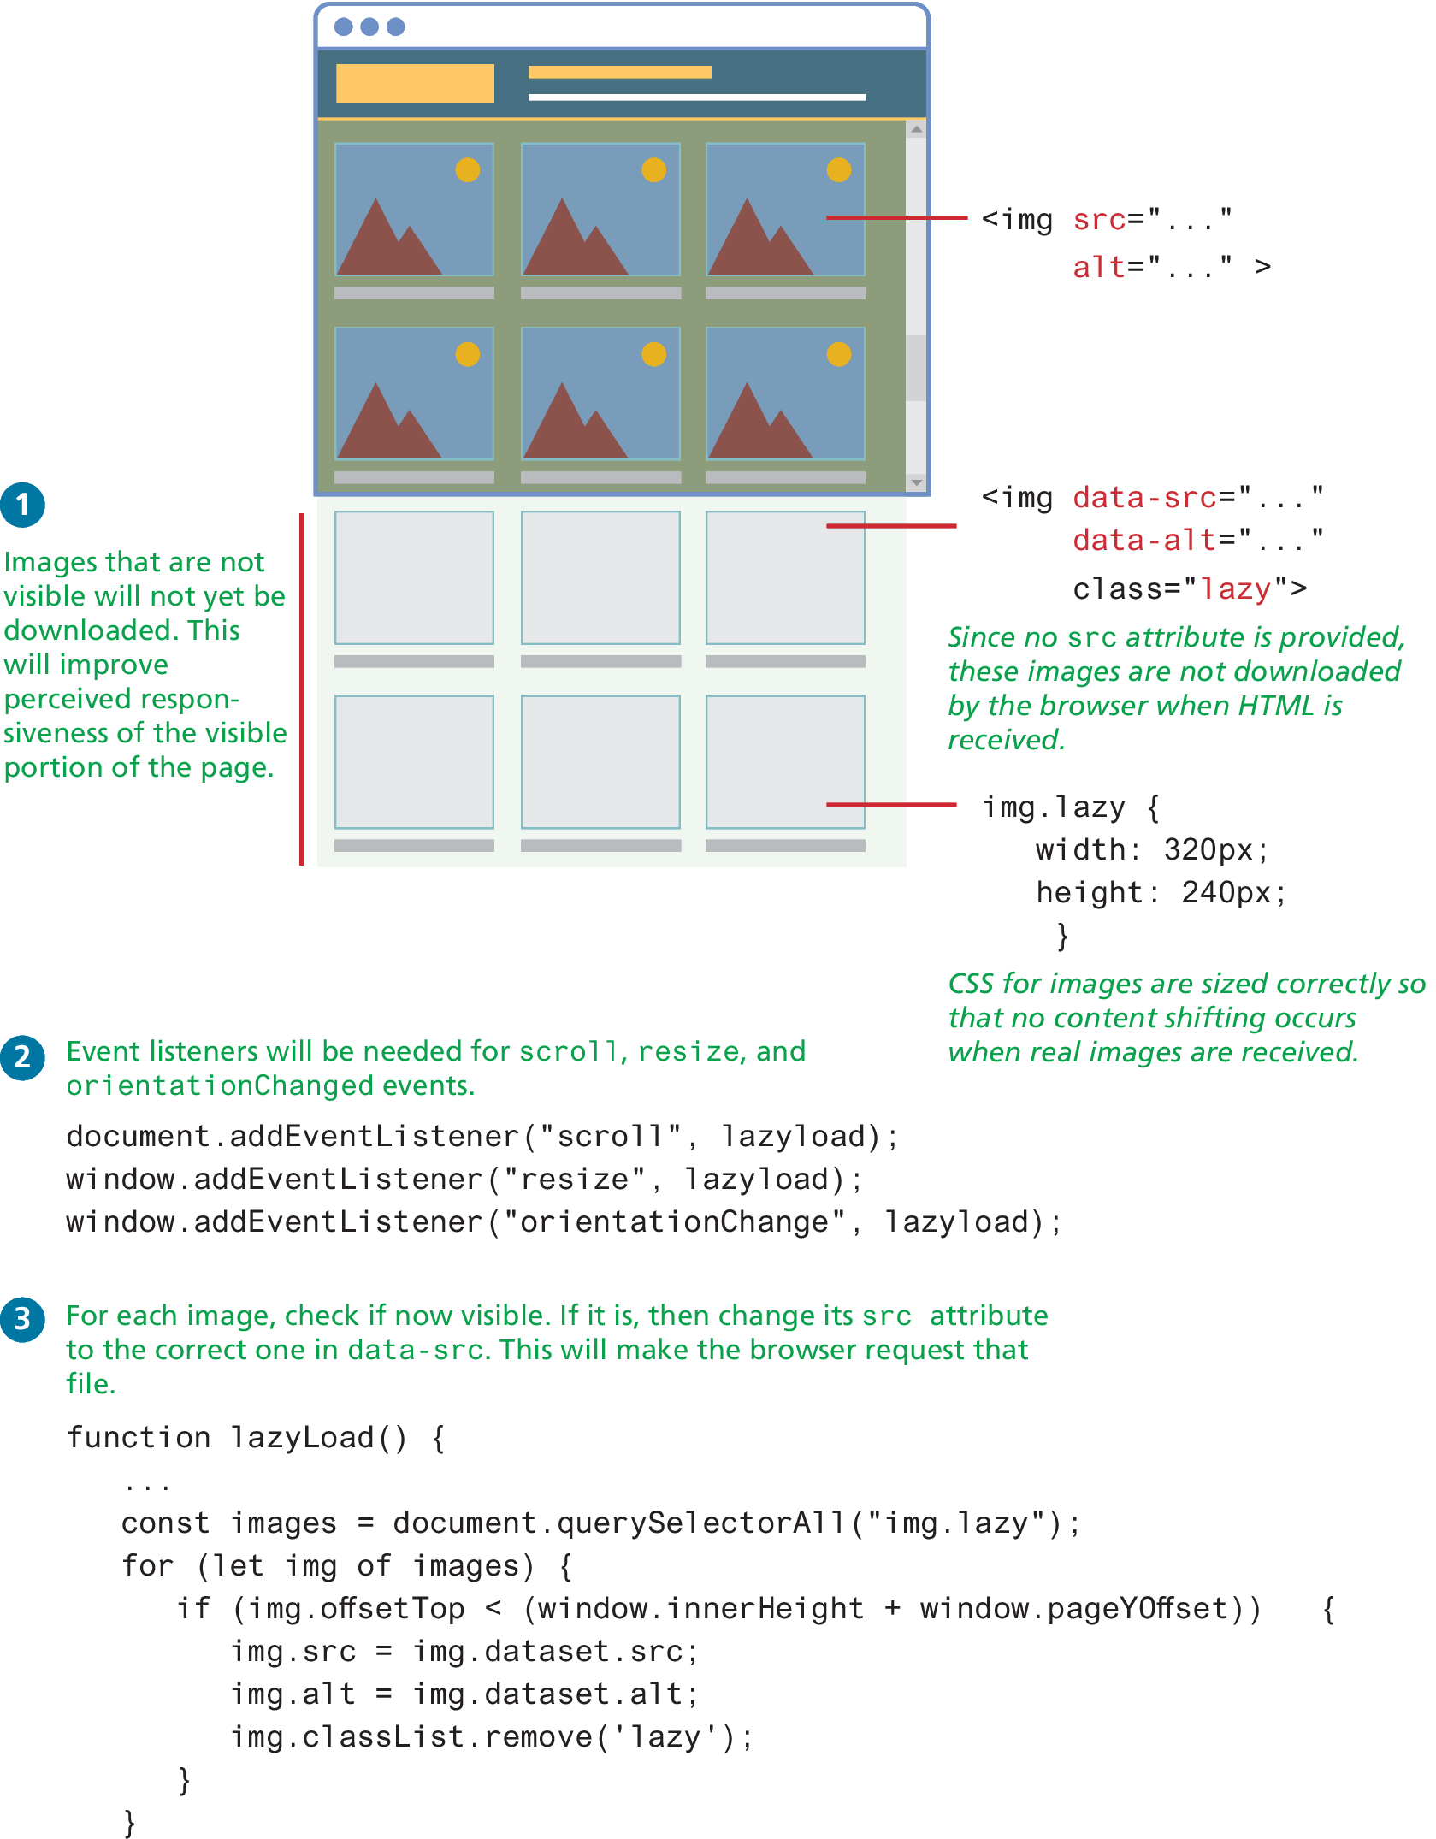
Lazy Loading

Slide 49
Forms in JavaScript
Chapter 2 covered the HTML for data entry forms.
JavaScript within forms is more than just the client-side validation of form data; JavaScript is also used to improve the user experience of the typical browser-based form.
As a result, when working with forms in JavaScript, we are typically interested in three types of events:
movement between elements,
data being changed within a form element, and
the final submission of the form.

Slide 50
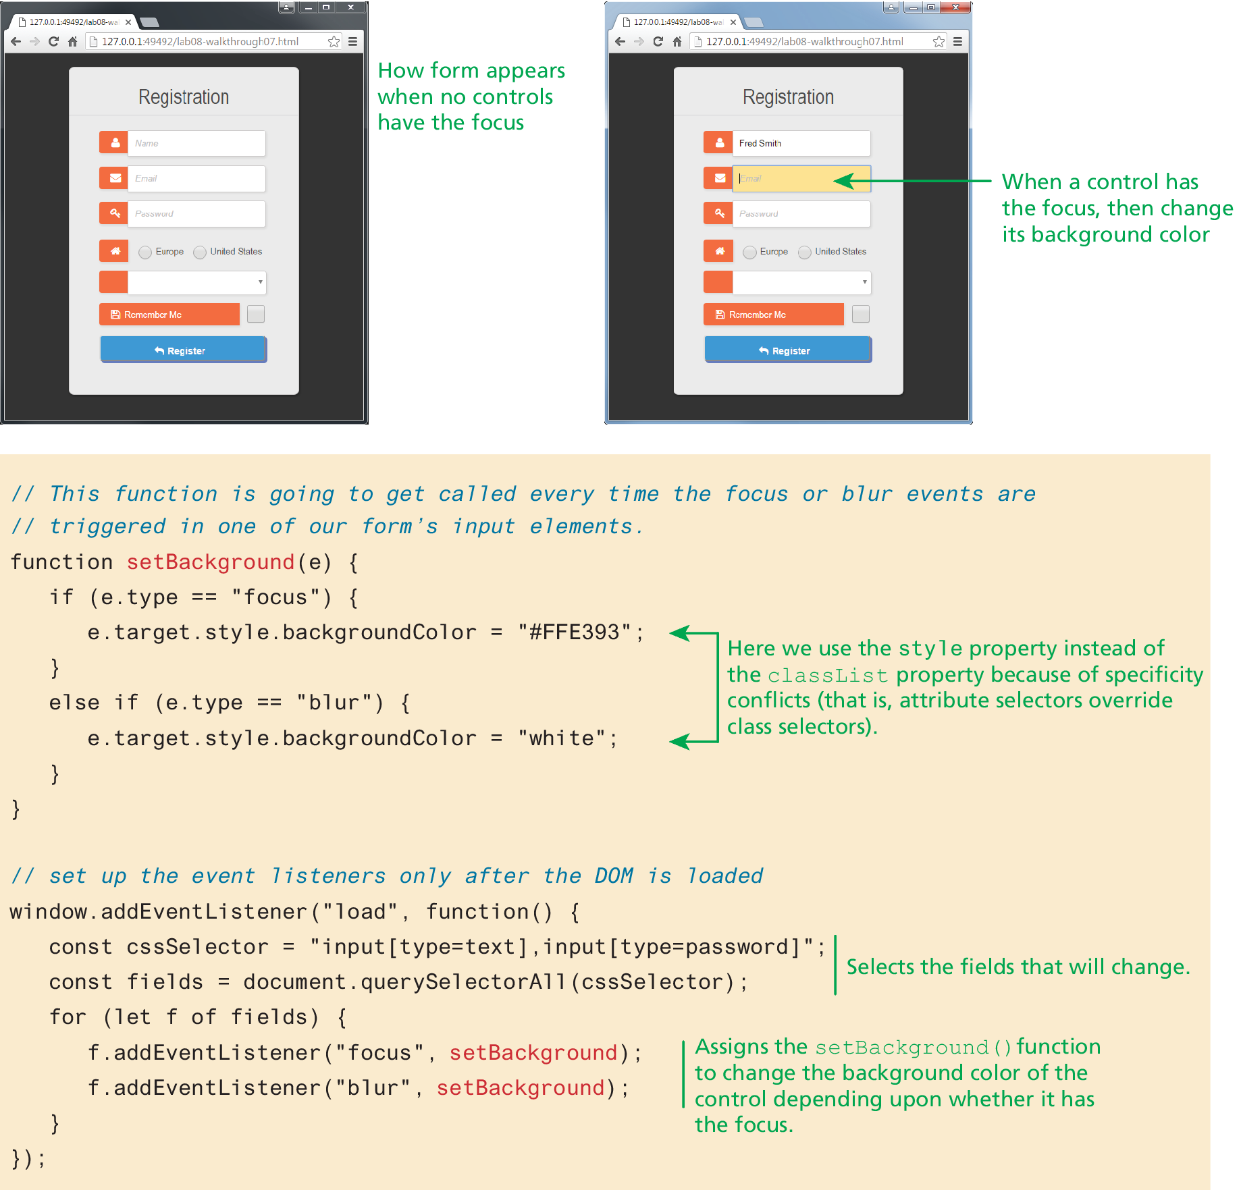
Responding to form movement events

Slide 51
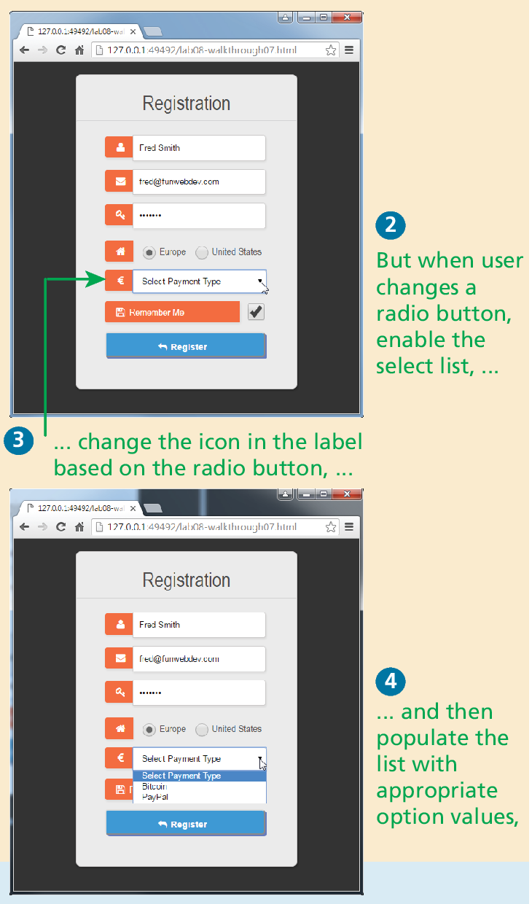
Responding to Form Changes Events
We may want to change the options available within a form based on earlier user entry. For instance, we may want the payment options to be different based on the value of the region radio button.
Figure 9.19 demonstrates how we can add event listeners to the change event of the radio buttons; when one of these buttons changes its value, then the callback function will set the available payment options based on the selected region. The listing also changes the associated payment label as well.

Slide 52
Validating a Submitted Form
Form validation continues to be one of the most common applications of JavaScript.
Checking user inputs to ensure that they follow expected rules must happen on the server side for security reasons (in case JavaScript was circumvented); checking those same inputs on the client side using JavaScript will reduce server load and increase the perceived speed and responsiveness of the form.
Some of the more common validation activities include email validation, number validation, and data validation.
In practice, regular expressions (covered in Section 9.6) are used to concisely implement many of these validation checks.

Slide 53
Empty Field Validation
const form = document.querySelector("#loginForm");
form.addEventListener("submit", (e) => {
const fieldValue = document.querySelector("#username").value;
if (fieldValue == null || fieldValue == "") {
// the field was empty. Stop form submission
e.preventDefault();
// Now tell the user something went wrong
console.log("you must enter a username");
}
});
LISTING 9.10 A simple validation script to check for empty fields

Slide 54
Determining which items in multiselect list are selected
const multi = document.querySelector("#listbox");
// using the options technique loops through each option and check if it is selected
for (let i=0; i < multi.options.length; i++) {
if (multi.options[i].selected) {
// this option was selected, do something with it ...
console.log(multi.options[i].textContent);
}
}
// the selectedOptions technique is simpler ... it only loops through the selected options
for (let i=0; i < multi.selectedOptions.length; i++) {
console.log(multi.selectedOptions[i].textContent);
}
LISTING 9.11 Determining which items in multiselect list are selected

Slide 55
Number Validation
Unfortunately, no simple functions exist for number validation like one might expect from a fullfledged library. Using parseInt(), isNAN(), and isFinite(), you can write your own number validation function.
Validating email, phone numbers, or social security numbers would include checking for blank fields and making use of isNumeric and regular expressions.
function isNumeric(n) {
return !isNaN(parseFloat(n)) && isFinite(n);
}
LISTING 9.12 A function to test for a numeric value

Slide 56
Submitting Forms
Submitting a form using JavaScript requires having a node variable for the form element. Once the variable, say, formExample is acquired, one can simply call the submit() method:
const formExample = document.getElementById("loginForm");
formExample.submit();
This is often done in conjunction with calling preventDefault() on the submit event.
It is possible to submit a form multiple times by clicking buttons quickly. The easiest way to protect against this is to simply disable the submit button immediately in the event handler for the submit event.

Slide 57
Regular Expressions
A regular expression is a set of special characters that define a pattern.
Their history predates the world of web development, as evidenced by the formal specification defined by the IEEE POSIX standard.
PHP, JavaScript, Java, the .NET environment, and most other modern languages support regular expressions.

Slide 58
Regular Expression Syntax
A regular expression consists of two types of characters: literals and metacharacters.
A literal is just a character you wish to match in the target (i.e., the text that you are searching within).
A metacharacter is a special symbol that acts as a command to the regular expression parser (there are 14, listed below).
. [ ] \ ( ) ^ $ | * ? { } +
Table 9.12 lists examples of typical metacharacter usage to create patterns;

Slide 59
Regular Expression Syntax (ii)
In JavaScript, regular expressions are case sensitive and contained within forward slashes. For instance
let pattern = /ran/;
will find matches in all three of the following strings:
'randy connolly'
'Sue ran to the store'
'I would like a cranberry’
Listing 9.13 contains a more complex regular expression whose development is described in textbook

Slide 60
Key Terms
blur
Document Object Model
(DOM)
document root
DOM document
object
DOM tree
Element Node
event bubbling
phase
event capturing phase
event delegation
event handler
event object
event propagation
event target
event type
focus
form events
frame events
iteral
keyboard events
linter
media events
metacharacter
mouse events
node
nodeList
regular expression
selection methods

Slide 61

Copyright
This work is protected by United States copyright laws and is provided solely for the use of instructors in teaching their courses and assessing student learning. Dissemination or sale of any part of this work (including on the World Wide Web) will destroy the integrity of the work and is not permitted. The work and materials from it should never be made available to students except by instructors using the accompanying text in their classes. All recipients of this work are expected to abide by these restrictions and to honor the intended pedagogical purposes and the needs of other instructors who rely on these materials.

